Slide 1
Data Structures
Computer Science, Purdue University
Copyright WILEY, Goodrich and Tamassia, Data Structures And Algorithms

Slide 2
Data Structures
Stacks and Queues
Stacks
Queues
Linked Lists
Double-Ended Queues
Computer Science, Purdue University

Slide 3
Data Structures
Stacks
A stack is a container of objects that are inserted and removed according to the last-in-first-out (LIFO)
principle.
Objects can be inserted at any time, but only the last (the most-recently inserted) object can be removed.
Inserting an item is known as “pushing” onto the stack. “Popping” off the stack is synonymous with removing an item.
Computer Science, Purdue University

Slide 4
Data Structures
The Stack Abstract Data Type
A stack is an abstract data type (ADT) that supports two main methods:
push(o): Inserts object o onto top of stack
Input: Object; Output: none
pop(): Removes the top object of stack and returns it; if stack is empty an error occurs
Input: none; Output: Object
The following support methods should also be defined:
size(): Returns the number of objects in stack
Input: none; Output: integer
isEmpty(): Return a boolean indicating if stack is empty.
Input: none; Output: boolean
top(): return the top object of the stack, without removing it; if the stack is empty an error occurs.
Input: none; Output: Object
Computer Science, Purdue University

Slide 5
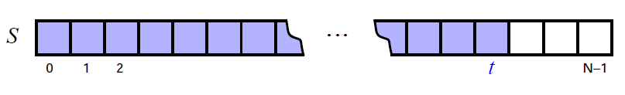
Data Structures
An Array Based Stack
Create a stack using an array by specifying a maximum size N for our stack, e.g. N = 1,000.
The stack consists of an N-element array S and an integer variable t, the index of the top element in array S.
Array indices start at 0, so we initialize t to -1
Computer Science, Purdue University

Slide 6
Data Structures
An Array Based Stack
Pseudo-code
Algorithm size():
return t +1
Algorithm isEmpty():
return (t<0)
Algorithm top():
if isEmpty() then
throw a StackEmptyException
return S[t]
Computer Science, Purdue University

Slide 7
Data Structures
An Array Based Stack
Pseudo-code
Algorithm push(o):
if size() = N then
throw a StackFullException
t = t + 1
S[t] = o
Algorithm pop():
if isEmpty() then
throw a StackEmptyException
e =S[t]
t = t-1
return e
Computer Science, Purdue University

Slide 8
Data Structures
An Array Based Stack
Each of the above method runs in constant time (O(1))
The array implementation is simple and efficient.
There is an upper bound, N, on the size of the stack. The arbitrary value N may be too small for a given application, or a waste of memory.
Computer Science, Purdue University

Slide 9
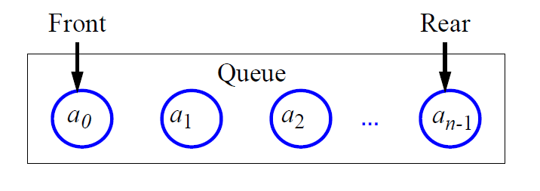
Data Structures
Queues
A queue differs from a stack in that its insertion and removal routines follows the first-in-first-out (FIFO) principle.
Elements may be inserted at any time, but only the element which has been in the queue the longest may be removed.
Elements are inserted at the rear (enqueued) and removed from the front (dequeued)
Computer Science, Purdue University

Slide 10
Data Structures
The Queue Abstract Data Type
The queue supports two fundamental methods:
enqueue(o): Insert object o at the rear of the queue
Input: Object; Output: none
dequeue(): Remove the object from the front of the queue and return it; an error occurs if the queue is empty
Input: none; Output: Object
These support methods should also be defined:
size(): Return the number of objects in the queue
Input: none; Output: integer
isEmpty(): Return a boolean value that indicates whether the queue is empty
Input: none; Output: boolean
front(): Return, but do not remove, the front object in the queue; an error occurs if the queue is empty
Input: none; Output: Object
Computer Science, Purdue University

Slide 11
Data Structures
An Array Based Queue
Create a queue using an array in a circular fashion
A maximum size N is specified, e.g. N = 1,000.
The queue consists of an N-element array Q and two
integer variables:
f, index of the front element
r, index of the element after the rear one
Computer Science, Purdue University

Slide 12
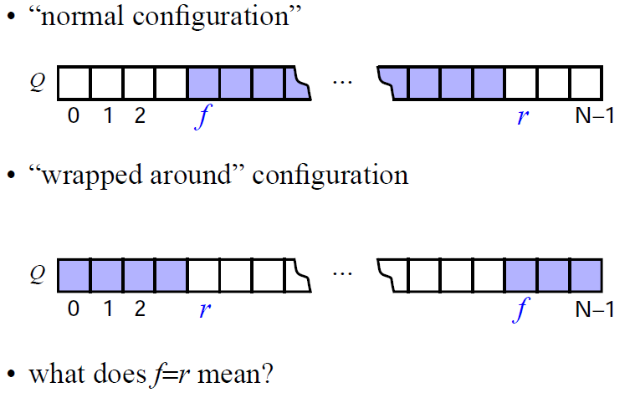
Data Structures
An Array Based Queue
Computer Science, Purdue University

Slide 13
Data Structures
An Array Based Queue
Pseudo-Code
Algorithm size():
return (N - f + r) mod N
Algorithm isEmpty():
return (f = r)
Algorithm front():
if isEmpty() then
throw a QueueEmptyException
return Q[f]
Computer Science, Purdue University

Slide 14
Data Structures
An Array Based Queue
Pseudo-Code
Algorithm dequeue():
if isEmpty() then
throw a QueueEmptyException
temp = Q[f]
f = (f + 1) mod N
return temp
Algorithm enqueue(o):
if size = N - 1 then
throw a QueueFullException
Q[r] = o
r = (r +1) mod N
Computer Science, Purdue University

Slide 15
Thank You

